Slide 1

IC HACK 2.0
Problem Statement: - Open Innovation : Climate Change Through Waste Management & Reduction
Team Name: GREEN WORLD
Institute Name: TRIDENT ACADEMY OF TECHNOLOGY

Slide 2
Idea Overview:-
Waste can have a significant impact on our climate as when it breaks down, it releases greenhouse gases like methane and carbon dioxide. These gases contribute to global warming and climate change. Additionally, improper waste management practices, such as landfilling and incineration, can release harmful pollutants into the air, further exacerbating environmental and health issues Improper waste management can have negative effects on our health. These pollutants can contaminate air, water, and soil posing risks to human health. It's important to practice responsible waste management and support initiatives that promote recycling, proper disposal, and reducing waste. .Focusing on the solution .
We would try to reduce the waste by our project . For waste reduction , bins in the societies would be connected to monitoring room of our team where each individual can scan before throwing waste so that we could monitor amount of waste and their respective weight .Regularly the data will be uploaded for a month if their waste amount will be exceed than the limit amount , our app will notify them to reduce waste amount . Also we have reward system for the people who are reducing their waste amount. A user can also see their uploaded waste amount in their profile by logging into our app .
We would try to focus on aware people through the following ways. We would have different videos in our app which would content recycling out of scrap content . We would connect different NGOs in our team who would conduct awareness and exhibition of some of scarp recycled products and showcase there importance to the audience. NGO’s would encourage audience through competitions and reward to the participants basically kids our upcoming pillars. We would design some interactive games in our application related to garbage collection which would impact the mind of user. In this manner people would get interested in changing themselves .

Slide 3
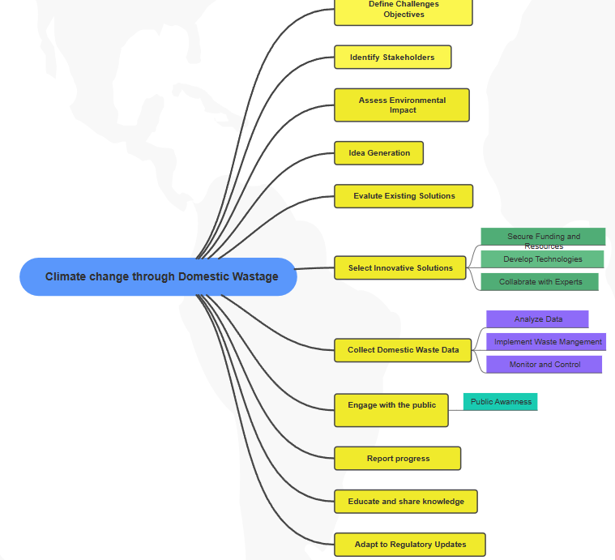
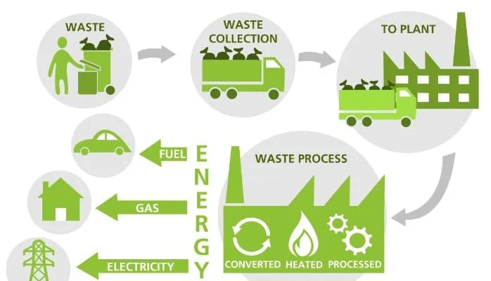
After collection of wastes, coming to segregation of it .We have planned to 1st give it to the industries segregating wastes and later we would use our own tashbot, GUTA ,convo waste to segregate wastes into 3 major components recyclables , organic , non-recyclables , which helps in proper waste management . For e.g.,-we have an idea to produce electricity from the plastic wastes and biogas from the vegetable peels, compost out of organic waste.
In this process we could contribute keeping our environment clean which would result in great climatic change which would solve the rising issue .

Slide 4
Market Prospects:-
1.Growing demand for sustainable solutions: With increasing awareness about environmental issues, there is a rising demand for waste management solutions that prioritize sustainability and efficiency . Additionally, innovations in recycling technologies and renewable energy generation from waste can create new revenue streams .
2. Government regulations and incentives: Many governments are implementing regulations and offering incentives to encourage waste management practices .
3. Opportunities for partnerships: 0ur project can open doors for collaborations with waste management companies, technology providers, and sustainability-focused organizations. These partnerships can help expand our reach and market presence .

Slide 5
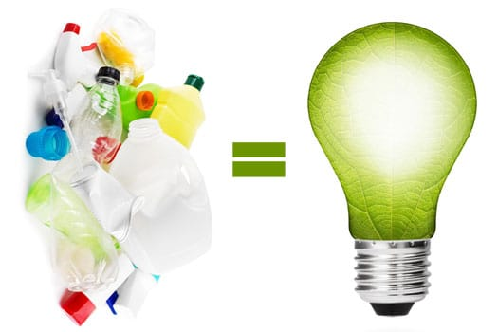
Future Scope:-
The future scope for our project is quite promising. As technology continues to advance, there will be opportunities to enhance the system with more advanced sensors, improved data analytics, and integration with other smart home devices that uses IoT devices for waste monitoring. By installing sensors in various society , the system can measure waste levels in real-time. This data can be used to track waste generation patterns, automate waste sorting, and provide insights for waste reduction . Also we have an idea to recycle the waste product and sell it in our app in a reasonable price .

Slide 6
Execution:-
To ensure a successful execution of the Smart Waste Management project :
Provide clear instructions: Make it easy for individuals to participate by providing clear and simple instructions for waste disposal and data entry.
Establish official rules: Develop official rules for the project, outlining terms and any limitations or restrictions.
Promote awareness: Use various channels to promote the project and raise awareness about the importance of waste management and reduction.
Ensure data accuracy: Regularly upload and update waste data to maintain accurate monitoring and analysis.
Implement notifications: Set up a notification system to alert users if their waste exceeds the limit, encouraging them to reduce waste and be mindful of their environmental impact.
Reward system: Implement a rewards program to incentivize and recognize individuals who actively participate in waste reduction efforts.
User-friendly interface: Design an user-friendly app interface that allows individuals to easily access and view their waste data.

Slide 7



Technical Overview:-
1. For data storage and analysis :- Cloud Platforms
2. For user interaction & reporting :- Mobile Applications
3. For Frontend :- html , CSS , JavaScript
4. For Backend :- JavaScript

Slide 8

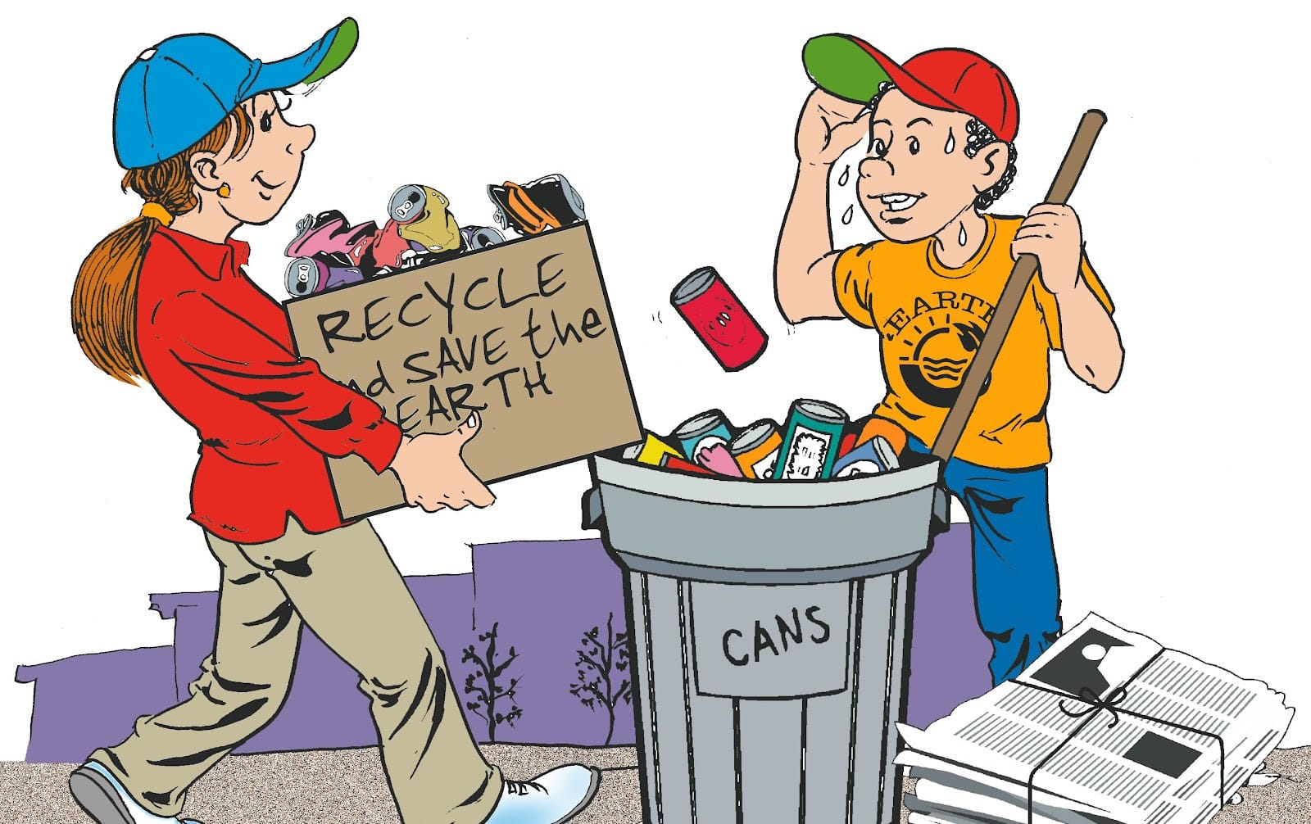
Conclusion:-
In conclusion, the Smart Waste Management project offers a comprehensive solution for domestic waste management. By utilizing devices and a user-friendly app, it empowers individuals to actively monitor and reduce their waste. With real-time data, notifications, and a reward system, we can create a more sustainable future.
Let's work together to make a positive impact on our environment !

Slide 9
Team Member Details :-
Team Leader Name: DIBYASA KHANDAI
Branch – B-tech Stream - CSE Year - II
Team Member Name: MANISHA NAYAK
Branch – B-tech Stream - CSE Year - II
Team Member Name: LIPSA PATTANAIK
Branch – B-tech Stream - CSE Year - II
Team Member Name: PRAMOD BISWAL
Branch – B-tech Stream - CSE Year - II
Team Mentor Name: ADITYA NARAYAN DAS
Category - Academic Expertise – WEB DEVELOPMENT Domain Experience (in years): 18

